Slide 1
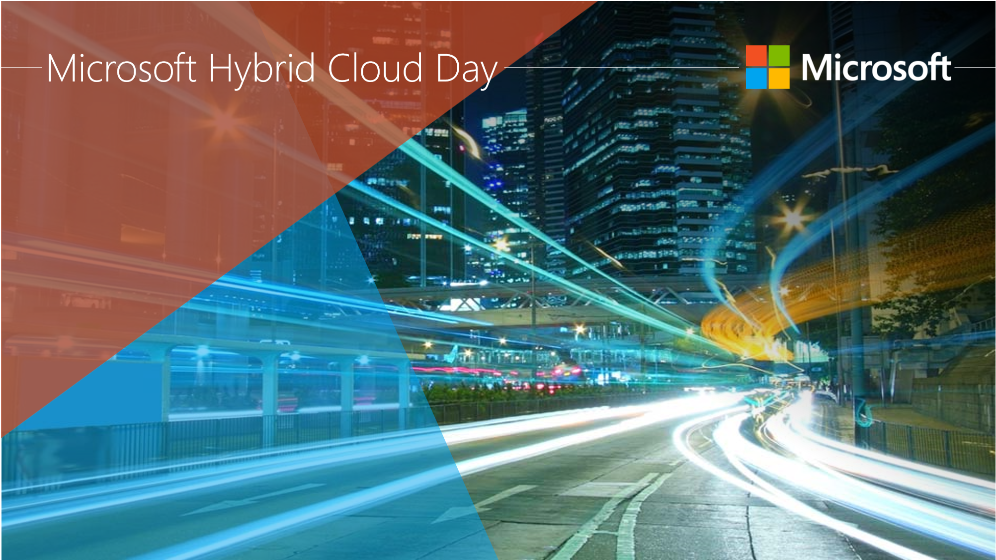
Cloud Application Development with Nano Server & Containers
Abdul Rasheed Feroz Khan
Microsoft MVP / Founder | CodeSizzler Technologies

Slide 2
Agenda
All about the Nano Server
What Nano Server is?
Considerations on Nano Server
Installation of Nano-Server on Azure
Deploy an application on Nano server
Containers
Functionality
Building applications using the Azure Containers

Slide 3
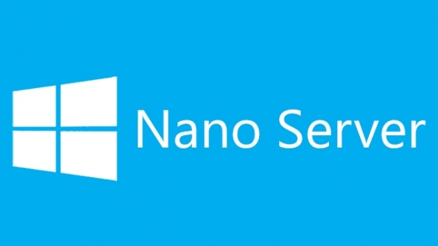
Nano Server
Very smaller server
Role of features
Managed remotely

Slide 4
Considerations on Nano server:
“Headless”
Support
AD - Domain Controller
Support for Group Policy
System Center Configuration Manager, etc.,

Slide 5
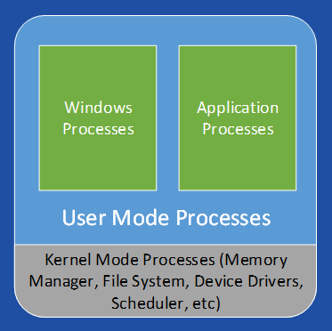
Containers - Functionality
Categorize applications into their own unique space.
Run multiple applications on a single host.
Transportable
Limitation

Slide 6
DEMO –
Deploying a Nano Server on Azure.
Deploy ACS & manage the portable applications.

Slide 7
Thank You !
Email: feroz@codesizzler.com
Twitter: @TechFero

